Slide 1


VISVESVARAYA TECHNOLOGICAL UNIVERSITY – BELAGAVI
MINI PROJECT PRESENTATION
ON
“CREDIT CARD FRAUD DETECTION”
BY
Vaishnavi Ekanathraddy Kolli 3PG22CS120
Sushma Deyannavar 3PG22CS110
Sushmita 3PG22CS111
Gowthami S 3PG23CS402
DEPARTMENT OF COMPUTER SCIENCE AND ENGINEERING
Ballari V.V Sangha’s
PROUDHADEVERAYA INSTITUTE OF TECHNOLOGY
T.B DAM ROAD.HOSAPETE-583225
(Affiliated to VTU, Belagavi, Karnataka & Recognized by AICTE, New Delhi)

Slide 2

Credit Card Fraud Detection Using Machine Learning
This presentation explores a robust machine learning approach to mitigate fraudulent transactions in credit card systems.

Slide 3
Introduction
Definition
Objective
Credit card fraud detection involves identifying unauthorized and potentially malicious activities in financial transactions.
To develop a machine learning model that accurately identifies fraudulent transactions while minimizing false positives.

Slide 4

Literature Survey
1
Credit Card Fraud Detection with Imbalanced Dataset Handling
2
Random Forest Classifier for Credit Card Fraud Detection
Demonstrated the efficiency of ensemble models like Random Forest in detecting fraud. Showed how feature selection improves model performance.
Proposed data resampling techniques to address class imbalance in fraud detection. Demonstrated the effectiveness of machine learning over rule-based methods for fraud detection.
3
Synthetic Minority Oversampling Technique (SMOTE) for Fraud Detection
SMOTE effectively balances datasets by oversampling the minority class, improving model accuracy and recall.

Slide 5
Problem Statement
Issue
Impact
Current fraud detection systems face challenges due to class imbalance in datasets where fraudulent transactions are rare. High false positives, leading to inefficiency. Inability to adapt to new fraud strategies.
Financial losses for businesses and customers. Reduced trust in digital financial systems. Increased manual efforts in verifying flagged transactions.

Slide 6
Proposed Solution
Objective
Methodology
Build a machine learning pipeline that addresses class imbalance and leverages robust classifiers for fraud detection.
Data Preprocessing and Feature Scaling. Balancing the dataset using SMOTE. Training multiple machine learning models, including Logistic Regression, Decision Tree, and Random Forest. Evaluating and comparing model performance. Deploying the best-performing model.

Slide 7
Implementation Process
Step 1: Data Loading and Preprocessing
1
Load the credit card dataset from Kaggle. Handle missing values and scale the features using StandardScaler.
2
Step 2: Exploratory Data Analysis
Analyze class distribution. Visualize feature correlations using a heatmap for better feature understanding.
Step 3: Balancing the Dataset
3
Apply SMOTE to oversample the minority class (fraudulent transactions) and balance the dataset.
4
Step 4: Model Training
Train Logistic Regression, Decision Tree, and Random Forest classifiers.
Step 5: Model Evaluation
5
Evaluate models using accuracy, confusion matrix, and classification report. Select the model with the best performance for deployment.
6
Step 6: Model Deployment
Save the best model (Random Forest) using Joblib for future use.

Slide 8
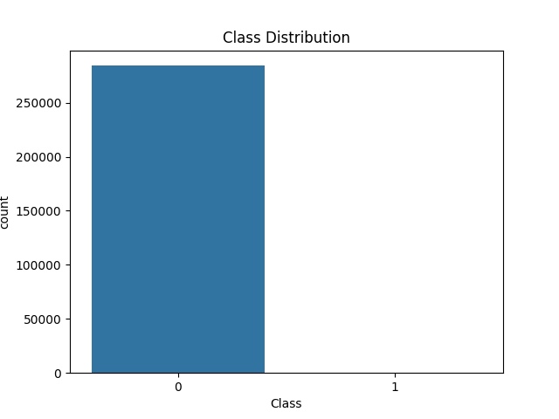
RESULT
This chart is a bar graph showing the distribution of two classes,
labeled as "0" and "1.“
Class "0" has a significantly larger count, with over 250,000 occurrences.
Class "1" has very few or no occurrences, as it is not visibly represented in the chart.

Slide 9
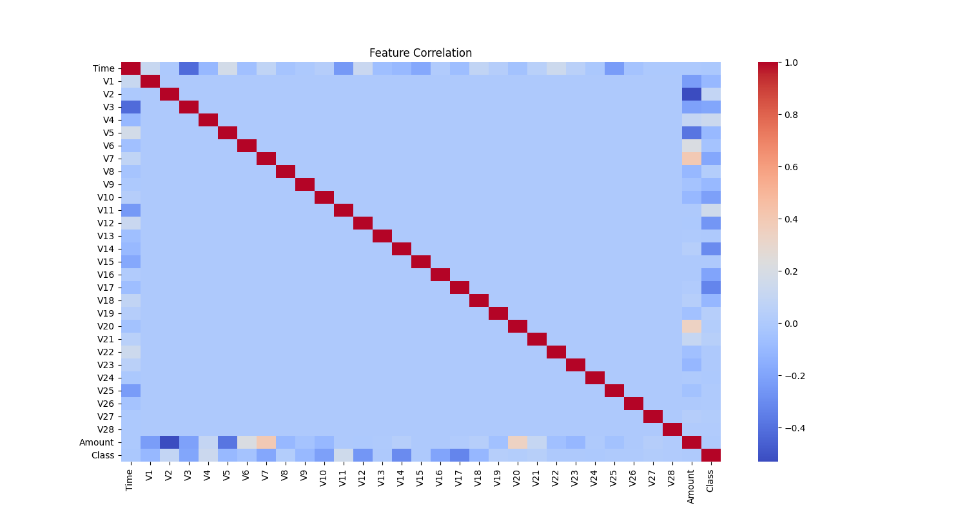
FEATURE CORRELATION
Diagonal line (red cells): Each feature is perfectly correlated with itself, which is why these cells have a correlation value of 1 (dark red).
Off-diagonal cells: These show the correlation between different features.
Blue colors indicate negative correlations (as one feature increases, the other decreases).
Red colors (less frequent) indicate positive correlations (as one feature increases, so does the other).
Lighter or neutral colors indicate weak or no correlation.

Slide 10




Future Enhancements
Advanced Techniques
1
Implement deep learning models like LSTMs and Autoencoders for better fraud detection. Explore hybrid models combining supervised and unsupervised learning.
Feature Engineering
2
Incorporate transaction context and user behavior features.
Real-Time Detection
3
Integrate the model into a real-time fraud detection system.
Model Optimization
4
Use GridSearchCV for hyperparameter tuning to improve model performance.

Slide 11
Conclusion
Summary
Key Impact
The project successfully developed a machine learning-based solution for credit card fraud detection. It addresses challenges like class imbalance and high false-positive rates, achieving robust and scalable results.
Enhanced security for financial transactions. Improved user trust in financial systems.

Slide 12


